Slide 1

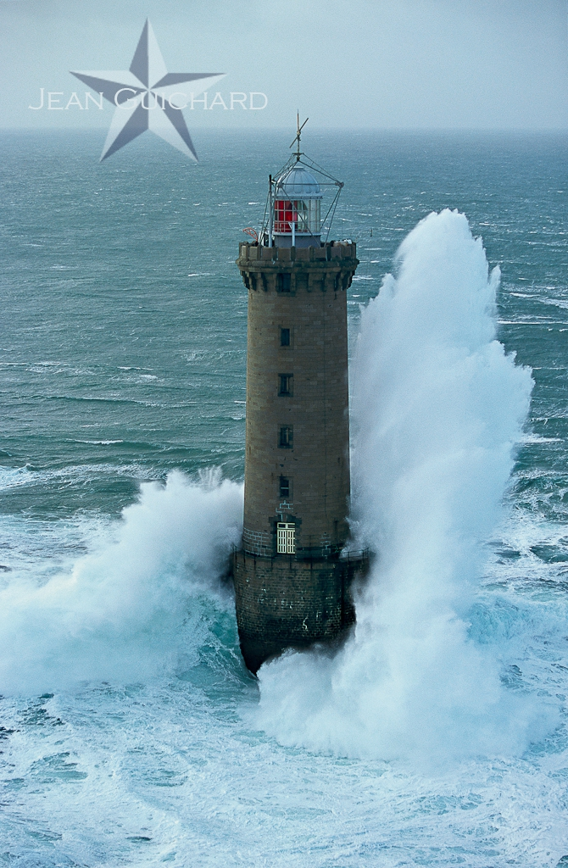
U.V. 5.4 Project Laser3DTour: Creation of a virtual tour of the Kéréon lighthouse from a point cloud
Supervised by:
Pierre Bosser
Nathalie Debèse
Michel Legris

Slide 2
Plan
I°) Overall Presentation
Context
Data
Software
II°) Poisson Surface Reconstruction
Normal Computation
Surface Function
Marching Cubes algorithm
Octree
III°) Implementation
IV°) Prototype Demonstration
V°) Conclusion

Slide 3
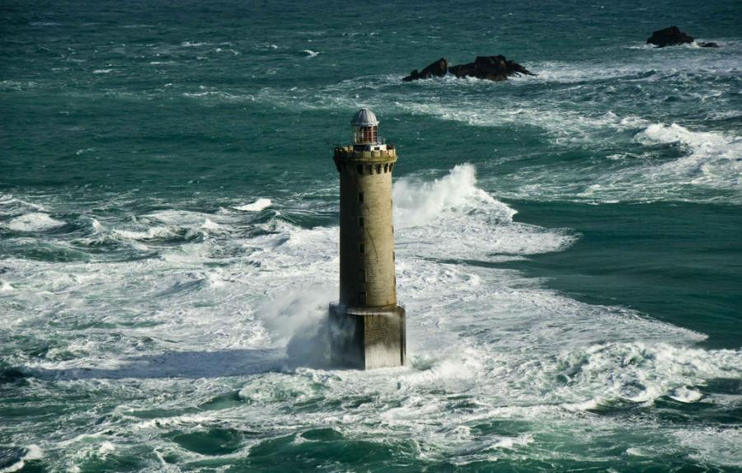
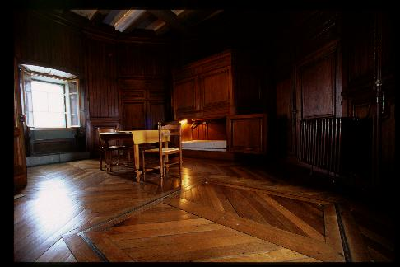
Context
Partnership between « Les Phares et Balises » and the ENSTA Bretagne
Create a 3D tour of Kéréon lighthouse that can be presented during the Brest 2016 International Maritime festival

Slide 4
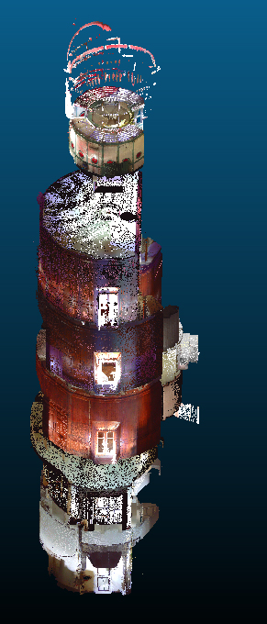
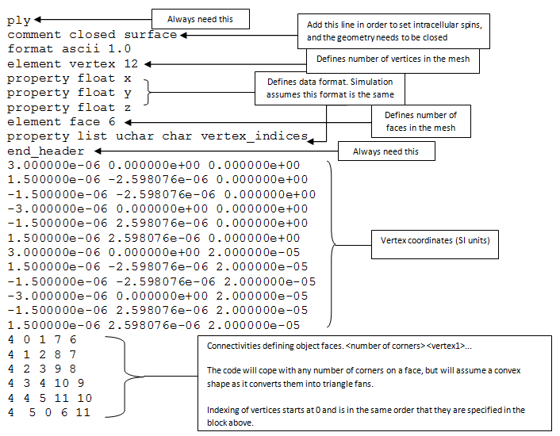
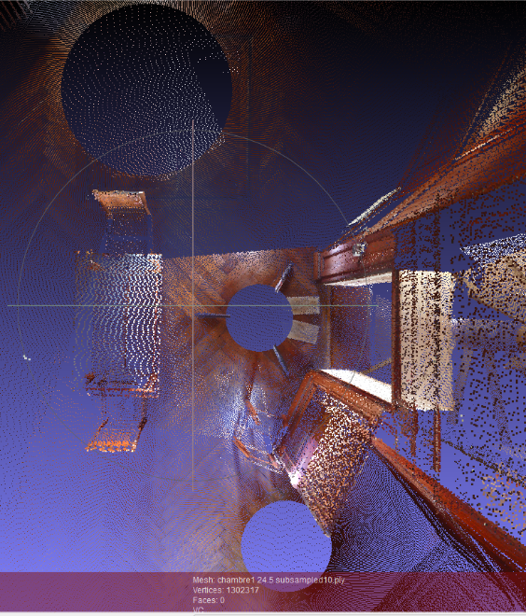
Data
ply format
(Polygon File Format)
Contained colors and vertex coordinates
Several Scans combined and subsampled

Slide 5



Software
MeshLab : an open source, and portable software for the processing and editing of unstructured 3D triangular meshes and point cloud
CloudCompare : a 3D point cloud processing software
Blender : an open source 3D graphics and animation software

Slide 6
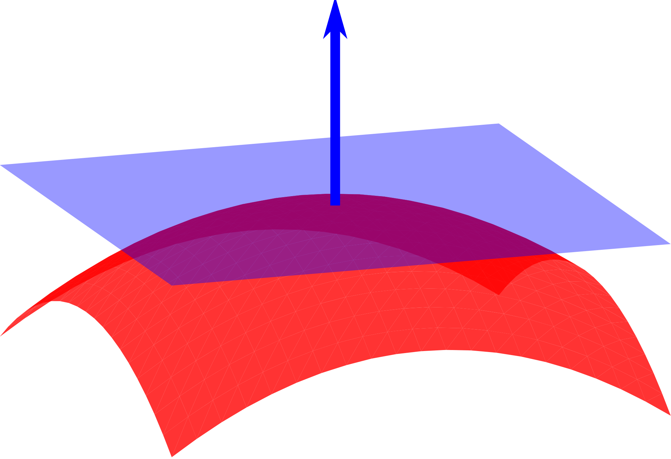
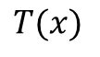
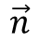
Normals Computation
$$\vec{n}$$
Used by the Poisson surface reconstruction algorithm
$$T(x)$$
Correspond to the normal to the tangent plane of a point

Slide 7
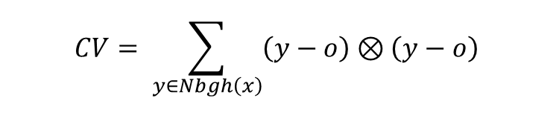
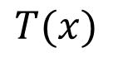
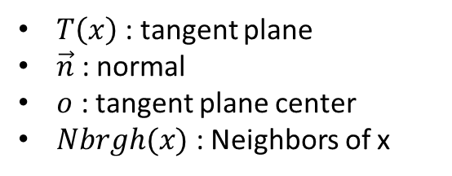
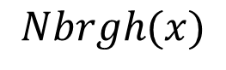
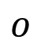
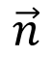
Normals Computation
$$\vec{n}$$
$$T(x)$$
$$o$$
$$Nbrgh(x)$$
$T\left(x\right)$: tangent plane
$\vec{n}$ : normal
$o$ : tangent plane center
$Nbrgh(x)$ : Neighbors of x
$$CV= \sum_{y∈Nbgh\left(x\right)}{\left(y−o\right)⊗\left(y−o\right)}$$

Slide 8
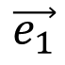
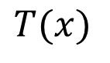
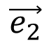
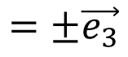
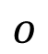
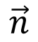
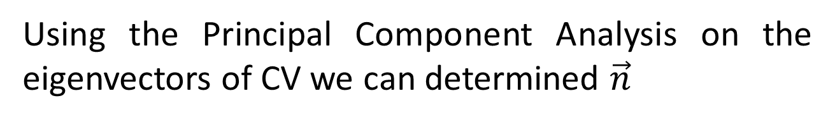
Normals Computation
Using the Principal Component Analysis on the eigenvectors of CV we can determined $\vec{n}$
$$\vec{n}$$
$$=±\vec{e_{3}}$$
$$\vec{e_{2}}$$
$$T(x)$$
$$o$$
$$\vec{e_{1}}$$

Slide 9
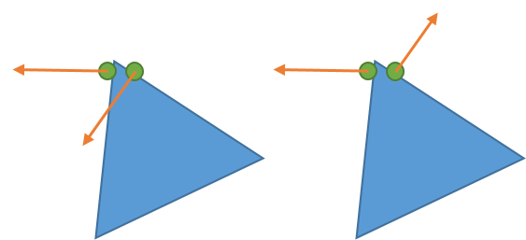

Normals Computation
Normals must now be correctly oriented
$$α= 1−\left|\hat{n_{i}}.\hat{n_{j}}\right|$$

Slide 10
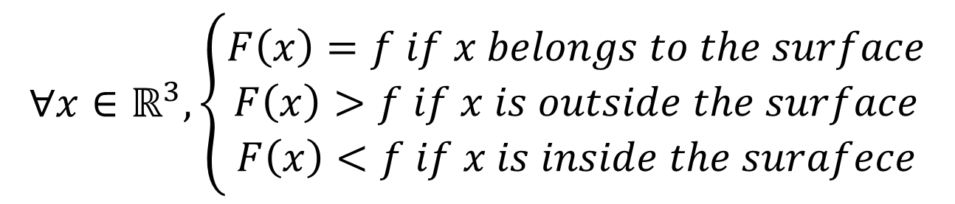
Surface Function
A surface function is a scalar function that defines the surface.
$$∀x∈ℝ^{3}, \left\{\begin{aligned}F\left(x\right)=f if x belongs to the surface \\ F\left(x\right)>f if x is outside the surface \\ F\left(x\right)<f if x is inside the surafece\end{aligned}\right.$$
F is defined as an isosurface and f is its isovalue

Slide 11
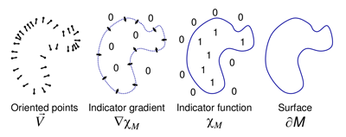
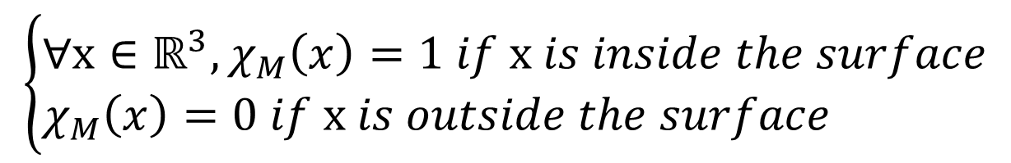
Surface Function
The surface function used into the Poisson algorithm is based on the indicator function
$$\left\{\begin{aligned}&∀x∈ℝ^{3}, χ_{M}\left(x\right)=1 if x is inside the surface \\ &χ_{M}\left(x\right)=0 if x is outside the surface\end{aligned}\right.$$

Slide 12
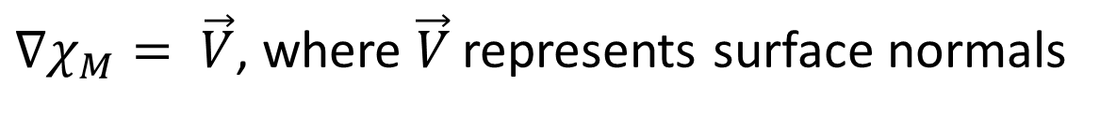
Surface Function
The indicator function can be found using the surface normals
$∇χ_{M}= \vec{V}$, where $\vec{V}$ represents surface normals

Slide 13
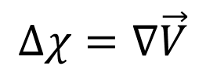
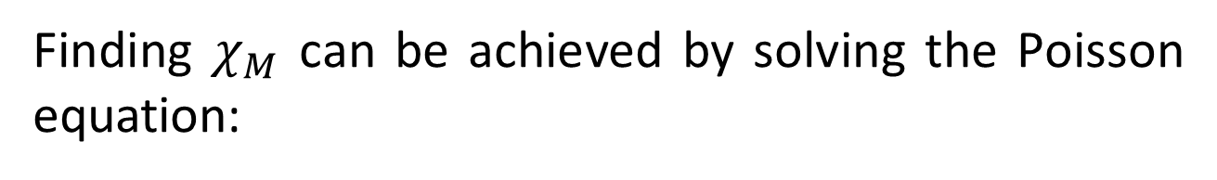
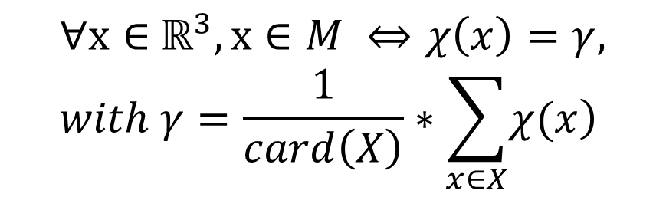
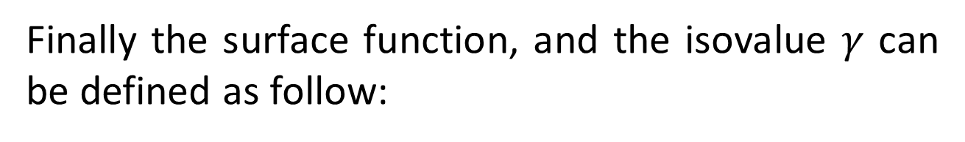
Surface Function
Finding $χ_{M}$ can be achieved by solving the Poisson equation:
$$Δχ=∇\vec{V}$$
Finally the surface function, and the isovalue $γ$ can be defined as follow:
$$∀x∈{ ℝ}^{3}, x∈M ⇔χ\left(x\right)=γ, with γ=\frac{1}{card\left(X\right)}∗\sum_{x∈X}{\left.χ(x\right)}$$

Slide 14
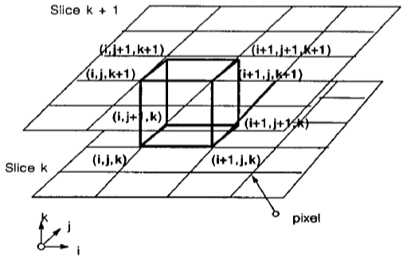
Marching Cubes Algorithm
The marching cubes algorithm allows to recreate the surface of a point cloud using its surface function.
Poisson Surface Reconstruction

Slide 15
Marching Cubes Algorithm
Compute the surface function for each vertex of the cube
Poisson Surface Reconstruction
Check if the vertex is above or below the surface
Create a triangle that separate the points outside from the points inside

Slide 16
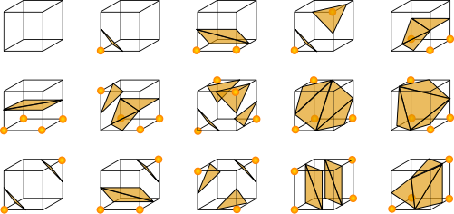
Marching Cubes Algorithm
The fifteen cases for the marching cube algorithm
Poisson Surface Reconstruction

Slide 17
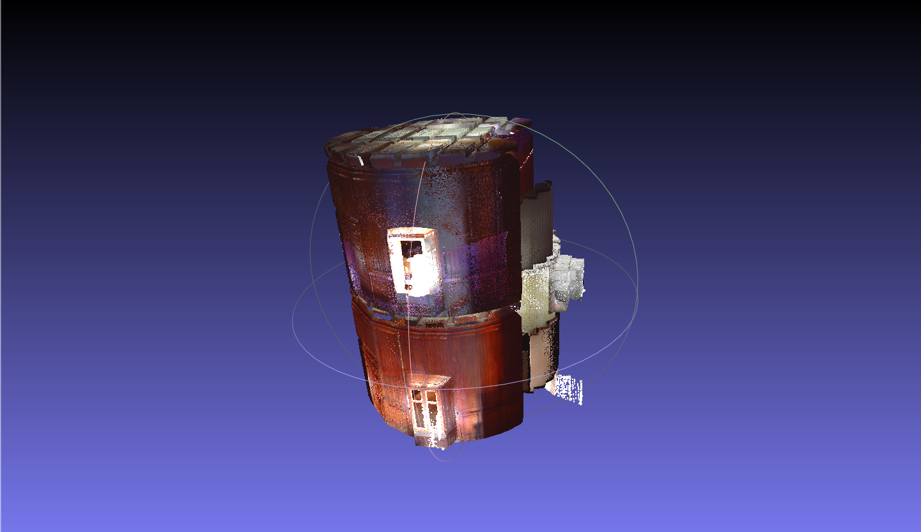
Implementation
Find a methodology to reconstruct a room of the lighthouse
Find a way to create a virtual tour of one room
Implementation

Slide 18
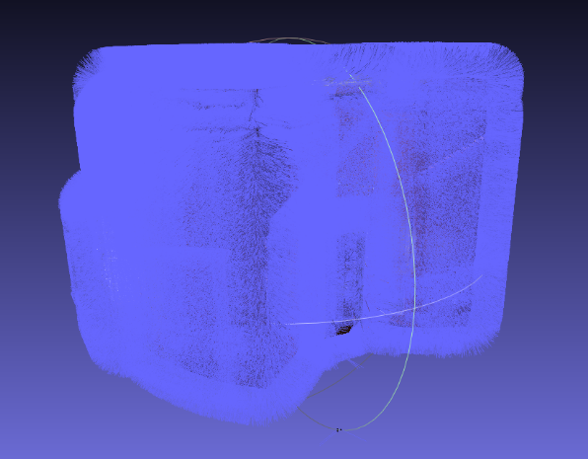
Methodology
Normals Computation
Cleaning the mesh
Poisson Surface reconstruction
Adding Colors
Create the virtual tour Using Blender
Implementation

Slide 19
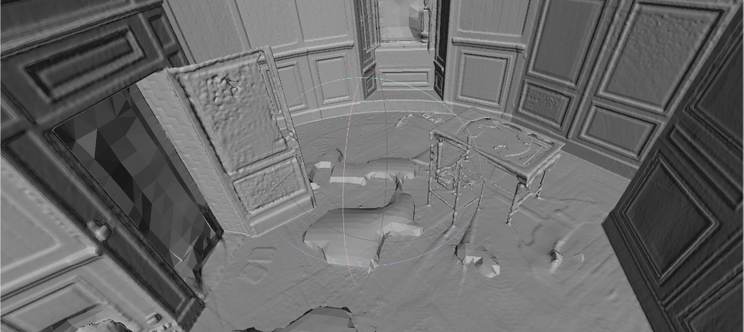
Methodology
Normals Computation
Cleaning the mesh
Poisson Surface reconstruction
Adding Colors
Create the virtual tour Using Blender
Implementation

Slide 20
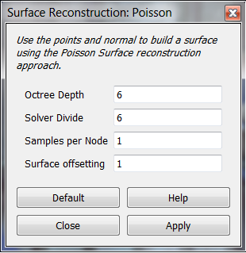
Methodology
Normals Computation
Cleaning the mesh
Poisson Surface reconstruction
Adding Colors
Create the virtual tour Using Blender
Implementation

Slide 21
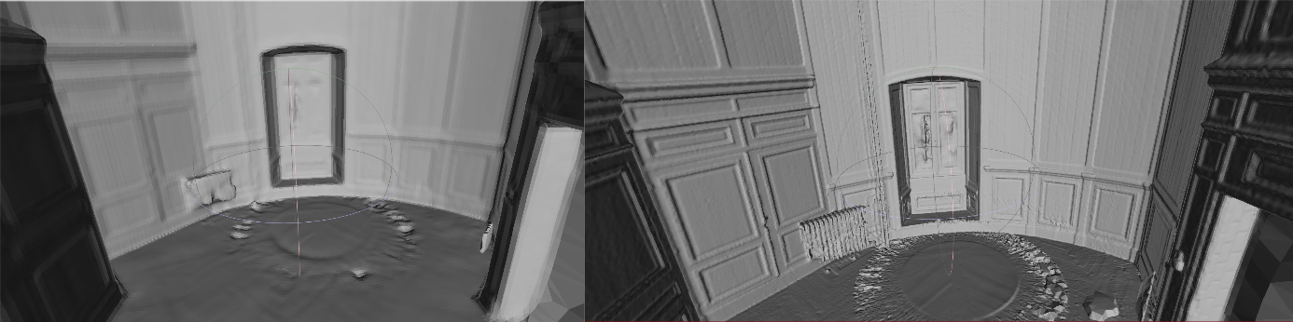
Methodology
Normals Computation
Cleaning the mesh
Poisson Surface reconstruction
Adding Colors
Create the virtual tour Using Blender
Implementation
Octree depth of 8
Octree depth of 10

Slide 22
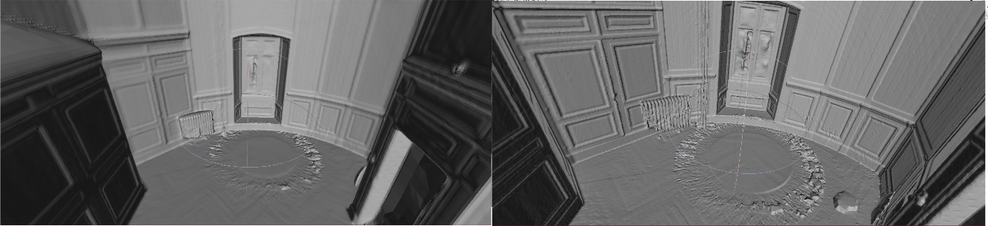
Methodology
Normals Computation
Cleaning the mesh
Poisson Surface reconstruction
Adding Colors
Create the virtual tour Using Blender
Implementation
1 sample per node
15 samples per node

Slide 23
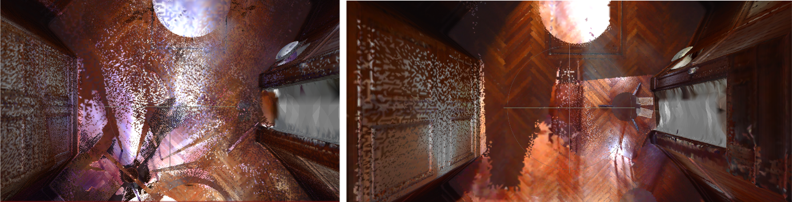
Methodology
Normals Computation
Cleaning the mesh
Poisson Surface reconstruction
Adding Colors
Create the virtual tour Using Blender
Implementation
Room 2
Room 1

Slide 24
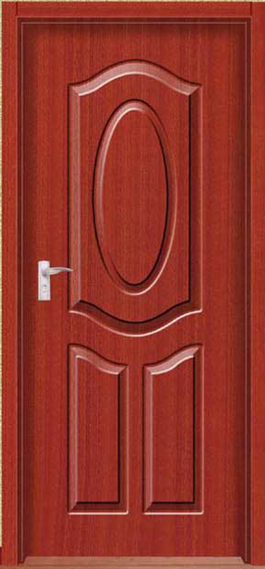
Prototype Demonstration
Normals Computation
Cleaning the mesh
Poisson Surface reconstruction
Adding Colors
Create the virtual tour Using Blender

Slide 25
Conclusion
A real project
Learn the basis on new and innovative technologies and methods
Learn how to conduct a project and to chose between different solutions

Slide 26

Questions ?

